Slide 1
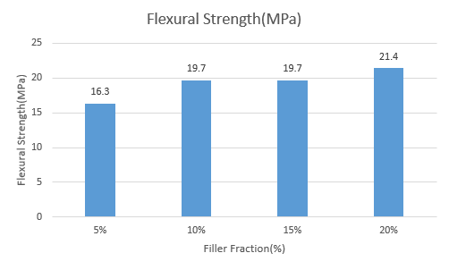
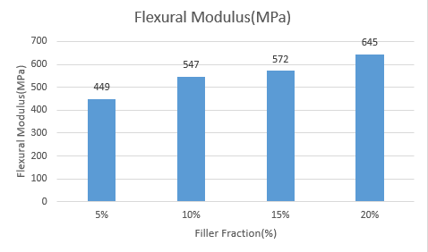
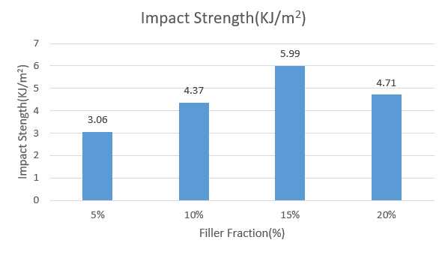
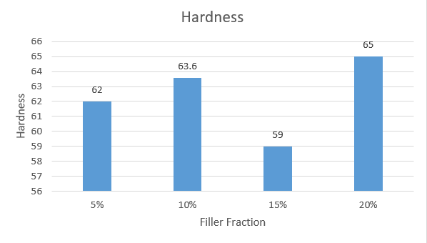
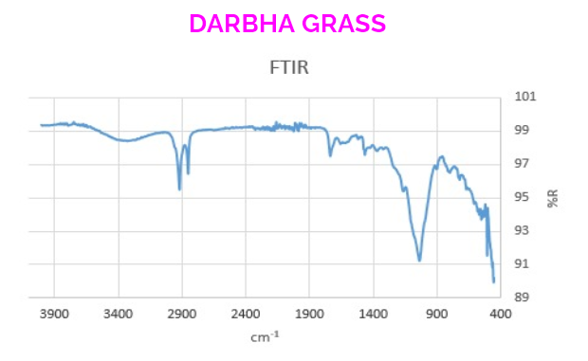
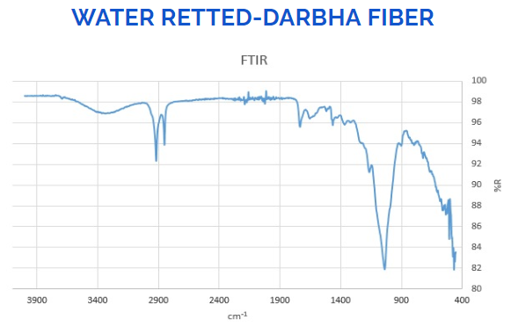
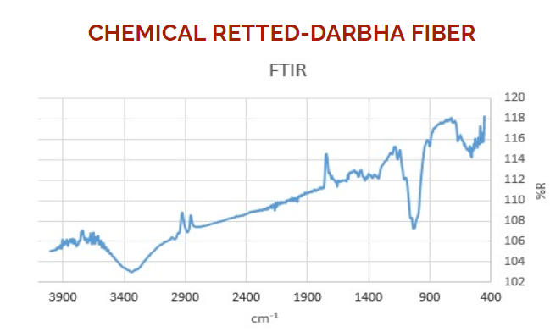
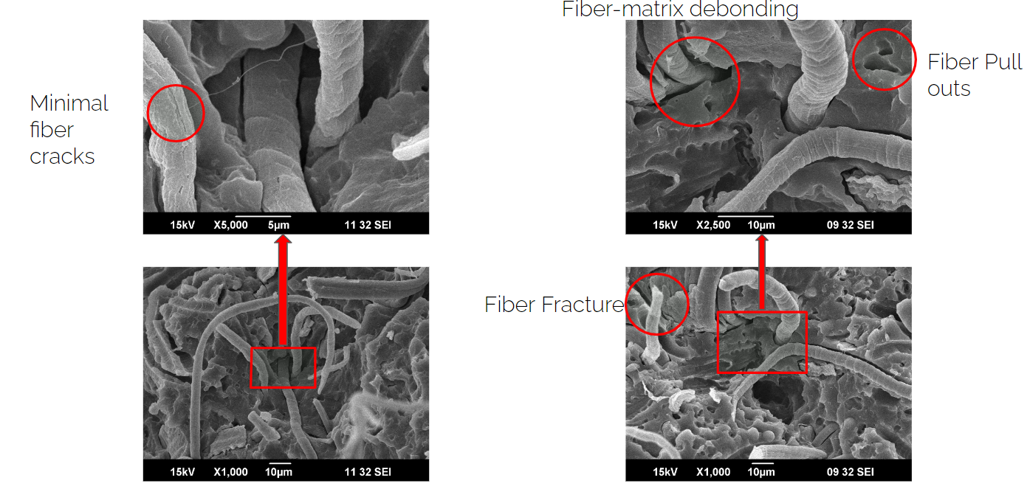
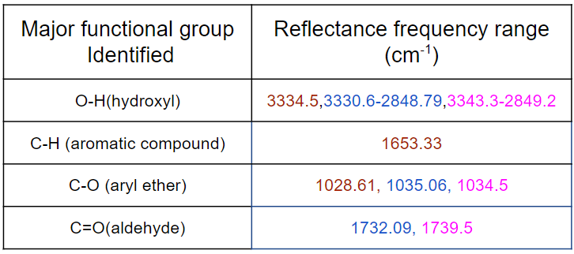
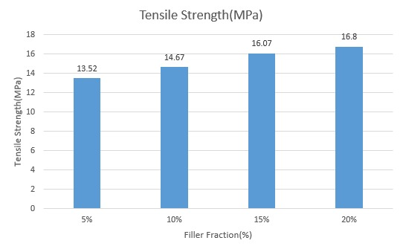
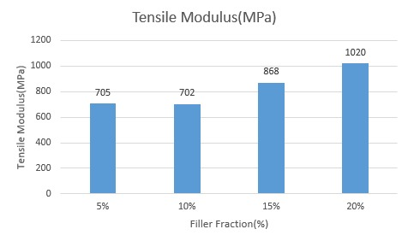
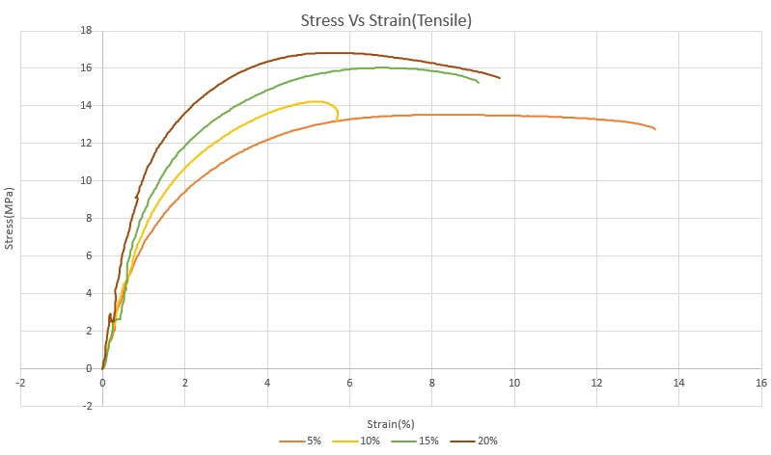
Valorizing darbha grass fibre to develop eco friendly bio-nanocomposite based on PP / EPDM for impact resistant application
Akhil.K(B.Tech-ME), Bharath.P.B(B.Tech-ME), Jonathan Reggie Ebenezer(B.Tech-ME), Sai Nived.M.V. (B.Tech-ME)
Department of Mechanical Engineering, Muthoot Institute of Technology & Science, Kochi, Kerala, 682308.
INTRODUCTION
Flexural testing
Darbha fiber is a cellulosic fiber with more than 70% cellulose which has not yet been explored in any major applications. The growing demand for natural fiber-reinforced composites, as well as the unique qualities of Darbha fibers highlight the need to investigate the mechanical properties of darbha fiber based composites. PP which is the lightest type of plastics with a density of 0.90 g/cm3, in its pure form does not possess much impact strength. So it has to be toughened for impact resistant applications, this can be achieved by the addition of an elastomer, which is EPDM that has high tearing resistance. In this study, .The composite were prepared by blending PP, EPDM & Dharba fibers using twin screw extruder and samples were prepared using injection molding .The PP/EPDM percentage is kept constant at 100/25 (wt. percentage) of 500g and the fiber percentage is varied. Samples with 5%,10%,15% and 20% fiber are made and tensile, flexural, impact, hardness, FTIR and DSC tests are conducted.
It has been observed from the graph, there is increase in value of flexural properties with increasing percentage ratios of Darbha in PP/EPDM blends. During flexural test information about flexural strength, flexural stress, flexural strain at break, flexural strain of the material can be obtained. Flexural modulus can be also obtained from this test.
Figure 4 : Filler strength Vs Filler Fraction
EXPERIMENTAL
An increase in flexural strength and flexural modulus was observed as the filler fraction increases. The flexural strength value increases from 16.3Mpa for 5% filler to 21.4Mpa for 20% filler samples. Similarly the flexural modulus also increase from 449 MPa for 5% filler to 645 MPa for 20% filler.
Table 1: Chemical composition of PP/EPDM/Darbha fiber- 4 combinations
Combination | PP | EPDM | Darbha | Total
1 | 375g | 125g | 25g | 525g
2 | 375g | 125g | 50g | 550g
3 | 375g | 125g | 75g | 575g
4 | 375g | 125g | 100g | 600g
Figure 5 : Flexural Modulus Vs Filler Fraction
Impact testing
As shown in the graph above, the impact strength increases as the fibre content increases. However, this trend is only observable up to a certain fibre level, beyond which the impact strength begins to decline. The 15 percent filler sample's impact intensity rises from 3.06 KJ/m2 to 5.99 KJ/m2. The value reduces to 4.71 KJ/m2 for the 20% sample. For strong impact strength, an ideal bonding level is necessary, which in our investigation is demonstrated by 15% fibre content.
FTIR Spectroscopy was done to identify the changes in the fiber for both water retting(21days) and chemical retting(24hours), and finally choosing the best fiber extracted from these two retting process for further use as filler material in PP/EPDM composite, in the IR wavelength range of 4000-400cm⁻¹
The Tensile test was conducted on a UTM machine to measures the force required to break the specimen. It provides much information about tensile strain, elongation, tensile modulus and elongation at break. It follows ASTM D 638 standard.
The Impact test was done using Izod test, and the impact strength is determined by measuring the loss of height in the pendulum swing. In the Izod test it is carried out under ASTM D 256.
The flexural test was done to obtain information about flexural strength, flexural stress, flexural strain at break, flexural strain of the material can be obtained. Flexural modulus can be also obtained from this test. A flexure test under load, produces tensile stress in the convex side of the specimen and compression stress in the concave side.
Rate of speed=(2zL)/(6d)
Where, Z=.01 (constant)
L=span length
d=depth / thickness
Deflection D =(2rL)/(6d)
Where, r = .05 (constant)
The hardness test measures the hardness of the specimen using Durometer which is followed by the ASTM D 2240 standard. The instrument is basically two types. Shore A and Shore D. Shore A is used to find the hardness of soft materials whereas Shore D is used to find the hardness of hard materials.In our study Shore D is being used. Type D has Hardened steel rod diameter between 1.1 mm – 1.4 mm , with a 30° conical point, 0.1 mm radius tip and force of 4.5 kg.
SEM analysis was done to obtain high-resolution imaging of the fracture surface morphology of the test specimens. It is used to inspect the test specimen for surface cracks, defects, impurities, or corrosion, and builds a final conclusion of how these findings from SEM image affects the overall performance of the obtained Test specimen composite having matrix phase, rubber phase, and reinforcing filler phase.
Figure 6 : Impact strength Vs Filler Fraction
Hardness testing
The general trend followed in case of hardness test is increase in hardness with increase in fibre content.This stays true for 5% with 62 N/mm2,10% with 63.6 N/mm2 and 20% with 65 N/mm2 .For 15% filler fraction the hardness value is found to be decreasing this may be due to fibre agglomeration or improper mixing.
Figure 7 : Hardness strength Vs Filler Fraction
b)
SEM Analysis
In our study the PP/EPDM specimen with 15% darbha fiber content that showed greater impact value is used for obtaining the SEM images. From the Scanning Electron Microscopy(SEM) it is evident that the fracture propagation is mainly due to:
Fiber-pull outs
Fiber-matrix debonding
From the above mechanical results, we can see a downward trend in Impact property after 15% of fiber content. This may be due to increase in fiber content increasing the pullouts and debonding.
a)
RESULTS AND DISCUSSION
FTIR Analysis
From comparing the spectrum of untreated and water retted darbha grass, we have an initial observation of both the spectrums having close resemblance, thus there is no major change of darbha grass after water retting. In the case of chemical retted darbha grass, there is a drastic change in the whole spectrum with greater intensity of O-H hydroxyl group that indicates cellulose presence with greater content.
And the C-H bond in chemical retted darbha grass spectrum, represents aromatic hydrocarbon group which is commonly found during the emergence of a natural fiber.
Figure 8: SEM images of the PP/EPDM/15% of Darbha fiber
Table : Major functional groups identified from the above spectrums using FTIR spectroscopy table
CONCLUSION
Successful fabrication of the Darbha fiber reinforced thermoplastic elastomeric composite has been done by injection moulding
The tensile, Impact, Hardness and flexural properties are found to increase with increase in fiber content
It was found from the study that the sample with 15% fiber content showed the highest impact resistance.
Properties like tensile,impact and flexural strength is found to be greatly affected by void content.
SEM results shows minor fiber cracks,fiber pullouts and debonding in some regions.
Possible future work can be carried out by selecting a suitable bonding material.
As there is no indication of the formation of darbha fiber using water retting process after 21 days, thus the Darbha fiber obtained from Chemical retting is used for further mechanical testing after blending with PP/EPDM.
Tensile testing
FUTURE SCOPE
Sound absorption-Darbha grass posses greater sound absorption properties with NRC(Noise Reduction Coefficient) of 8.5
Supercapacitor- Darbha grass has good electrochemical properties and can help in creating a suer-capacitor with excellent energy density and power density
Radiation shielding- Darbha grass shows the ability of shielding from X-Ray radiations
ACKNOWLEDGMENTS
Figure 1 :Tensile strength Vs Filler Fraction
Figure 2 : Tensile Modulus Vs Filler Fraction
We thank for their financial and technical support of this project.
The figure 1 graph above shows the tensile strength of the various fibre mixes. It shows that when the fibre content rises, the tensile strength increases as well. The tensile strength increases from 13.52 MPa at 5% fibre content to 16.8 MPa at 20% fibre content.
From figure 2 graph, increase in fibre results in a rise in tensile modulus, which is attributable to the reinforcing fibre content.
From figure 3, as the amount of fibre grows, stress increases, as shown in the graph above. This is due to the fact that as the amount of fibre in the diet increases, so does the amount of stress in the body.
REFERENCE
Figure 3 : Stress Vs Strain

Slide 2
Valorizing darbha grass fibre to develop eco friendly bio-nanocomposite based on PP / EPDM for impact resistant application
Akhil.K(B.Tech-ME), Bharath.P.B(B.Tech-ME), Jonathan Reggie Ebenezer(B.Tech-ME), Sai Nived.M.V. (B.Tech-ME)
Department of Mechanical Engineering, Muthoot Institute of Technology & Science, Kochi, Kerala, 682308.
INTRODUCTION
Polypropylene(PP)-HG350FG
Plastic polymer material
Light weight
Low cost
Market share:65-75%
Ethylene Propylene Diene Monomer(EPDM)- Keltan 9565Q
Synthetic Rubber
Resistance to oxygen, ozone, UV, and heat
Darbha grass- Desmostachya bipinnata
Cellulose-70.58%
Widely available
No major studies conducted
PP
EPDM
Darbha
Eco friendly bio-nanocomposite

